Slide 1
EN.601.414/614 Computer Networks Final Review
Xin Jin
Fall 2020 (TuTh 1:30-2:45pm on Zoom)
https://github.com/xinjin/course-net
Notes:
Slides adapted from similar courses at Princeton, Stanford, UC Berkeley, University of Michigan, etc.

Slide 2
Final Exam
Time: 7pm-9pm, Wednesday, December 16
Location: online
Form: open-book
Can use slides for reference
Can use a calculator
Anything else is prohibited
Focus on materials after midterm
Materials before midterm will be tested, but not a focus
Senior option
Your final exam score will be the same as your midterm score
Contact the course staff on piazza before December 11 (this Friday) if you want to use the senior option or if you need any special accommodation

Slide 3
This review
Walk through what you’re expected to know at this point: key topics, important aspects of each
Not covered in review does NOT imply you don’t need to know it
But if it’s covered today, you should know it
Summarize, not explain
Stop me when you want to discuss something further!

Slide 4
The networking stack
Lower three layers implemented everywhere
Top two layers implemented only at hosts
Application
Application
Transport
Transport
Network
Network
Network
Datalink
Datalink
Datalink
Physical
Physical
Physical
End system
Switch
End system

Slide 5
Topics
Network layer (lectures 12–15)
Intra-domain routing
Inter-domain routing
Link layer (lectures 17–18)
Ethernet
Topics in networking (lectures 16, 19–21)
Programmable networks
Wireless
Security
Misc

Slide 6
Network layer
Present everywhere
Performs addressing, forwarding, and routing, among other tasks
Application
Application
Transport
Transport
Network
Network
Network
Datalink
Datalink
Datalink
Physical
Physical
Physical
End system
Switch
End system

Slide 7
Forwarding vs. routing
Forwarding: “data plane”
Directing one data packet
Each router using local routing state
Routing: “control plane”
Computing the forwarding tables that guide packets
Jointly computed by routers using a distributed algorithm
Very different timescales!

Slide 8
Routing: Local vs. global view
Local routing state is the forwarding table in a single router
By itself, the state in a single router cannot be evaluated
It must be evaluated in terms of the global context
Global state refers to the collection of forwarding tables in each of the routers
Global state determines which paths packets take

Slide 9
“Valid” routing state
Global state is “valid” if it produces forwarding decisions that always deliver packets to their destinations
Goal of routing protocols: compute valid state
How can we tell if routing state if valid?
Notes:
What could go wrong?

Slide 10
Necessary and sufficient condition
Global routing state is valid if and only if:
There are no dead ends (other than destination)
There are no loops
A dead end is when there is no outgoing link (next-hop)
A packet arrives, but the forwarding decision does not yield any outgoing link
A loop is when a packet cycles around the same set of nodes forever

Slide 11
Least-cost routes
Least-cost routes provide an easy way to avoid loops
No reasonable cost metric is minimized by traversing a loop
Least-cost paths form a spanning tree for each destination rooted at that destination

Slide 12
Intra-domain routing
Link-state (LS) routing protocol
Dijkstra’s algorithm
Broadcast neighbors’ info to everyone
Distance vector (DV) routing protocol
Bellman-Ford algorithm
Gossip to neighbors about everyone

Slide 13
Similarities between LS and DV routing
Both are shortest-path based routing
Minimizing cost metric (link weights) a common optimization goal
Routers share a common view as to what makes a path “good” and how to measure the “goodness” of a path
Due to shared goal, commonly used inside an organization
RIP and OSPF are mostly used for intra-domain routing

Slide 14
Comparison of LS and DV routing
Messaging complexity
LS: with N nodes, E links, O(NE) messages sent
DV: exchange between neighbors only
Speed of convergence
LS: relatively fast
DV: convergence time varies
Count-to-infinity problem
Robustness: what happens if router malfunctions?
LS:
Node can advertise incorrect link cost
Each node computes its own table
DV:
Node can advertise incorrect path cost
Each node’s table used by others (error propagates)

Slide 15
Addressing is key to scalable inter-domain routing
Ability to aggregate addresses is crucial for
State: Small forwarding tables at routers
Much less than the number of hosts
Churn: Limited rate of change in routing tables

Slide 16
Classful addressing
Three classes
8-bit network prefix (Class A),
16-bit network prefix (Class B), or
24-bit network prefix (Class C)
Example: an organization needs 500 addresses.
A single class C address is not enough (<500 hosts)
Instead, a class B address is allocated (~65K hosts)
Huge waste!

Slide 17
CIDR: Classless inter-domain routing
Flexible division between network and host addresses
Offers a better tradeoff between size of the routing table and efficient use of the IP address space

Slide 18
Administrative structure shapes Inter-domain routing
ASes want freedom to pick routes based on policy
ASes want autonomy
ASes want privacy

Slide 19
Topology & policy shaped by inter-AS business relationship
Three basic kinds of relationships between ASes
AS A can be AS B’s customer
AS A can be AS B’s provider
AS A can be AS B’s peer
Business implications
Customer pays provider
Peers don’t pay each other
Exchange roughly equal traffic

Slide 20
Business relationships
Relations between ASes
Business implications
Customers pay provider
Peers don’t pay each other
provider
customer
peer
peer

Slide 21
Routing follows the money!
Q
Pr
Cu
Peer
Peer
A
B
C
D
E
F
traffic allowed
traffic not allowed
ASes provide “transit” between their customers
Peers do not provide transit between other peers

Slide 22
Valley-Free Routing
Number links as (+1, 0, -1) for customer-to-provider, peer and provider-to-customer
In any path should only see sequence of +1, followed by at most one 0, followed by sequence of -1
Example question: show why the traffic is allowed or not allowed in the previous slide with valley-free routing

Slide 23
Example Question
Q
Pr
Cu
Peer
Peer
A
B
C
D
E
F
traffic allowed
traffic not allowed
Show why the traffic is allowed or not allowed with valley-free routing

Slide 24
BGP inspired by Distance-Vector with four differences
Shortest-path routes may not be picked to enforce policy
Path-Vector routing to avoid loops
Selective route advertisement may affect reachability
Routes may be aggregated for scalability

Slide 25
Policy dictates how routes are “selected” and “exported”
Route export
Route selection
P
A
B
Can reach 128.3/16
blah blah
Q
C
Selection: Which path to use?
Controls whether/how traffic leaves the network
Export: Which path to advertise?
Controls whether/how traffic enters the network
Notes:
Arrows: routing messages!

Slide 26
eBGP, iBGP, and IGP
eBGP: BGP sessions between border routers in different ASes
Learn routes to external destinations
iBGP: BGP sessions between border routers and other routers within the same AS
Distribute externally learned routes internally
IGP: “Interior Gateway Protocol” = Intra-domain routing protocol
Provide internal reachability
E.g., OSPF, RIP

Slide 27
eBGP, iBGP, and IGP together
Learn routes to external destination using eBGP
Distribute externally learned routes internally using iBGP
Travel shortest path to egress using IGP

Slide 28
Topics
Network layer (lectures 12–15)
Intra-domain routing
Inter-domain routing
Link layer (lectures 17–18)
Ethernet
Topics in networking (lectures 16, 19–21)
Programmable networks
Wireless
Security
Misc

Slide 29
Data link layer
Provides four primary services
Framing
Encapsulates network layer data
Link access
Medium access control (MAC) protocol defines when to transmit frames
Reliable delivery
Primarily for mediums with high error rates (e.g., wireless)
Error detection and correction

Slide 30
Point-to-point vs. broadcast medium
Point-to-point: dedicated pairwise communication
E.g., long-distance fiber link
E.g., Point-to-point link b/n Ethernet switch and host
Broadcast: shared wire or medium
Traditional Ethernet (pre ~2000)
802.11 wireless LAN

Slide 31
Random access MAC protocols
When node has packet to send
Transmit at full channel data rate w/o coordination
Two or more transmitting nodes ⇒ collision
Data lost
Random access MAC protocol specifies
How to detect and recover from collisions
Examples
ALOHA and Slotted ALOHA
CSMA, CSMA/CD, CSMA/CA (wireless)

Slide 32
CSMA (Carrier Sense Multiple Access)
CSMA: listen before transmit
If channel sensed idle: transmit entire frame
If channel sensed busy, defer transmission
Human analogy: don’t interrupt others!
Does not eliminate all collisions
Why?

Slide 33
CSMA/CD (Collision Detection)
CSMA/CD: carrier sensing, deferral as in CSMA
Collisions detected within short time
Colliding transmissions aborted, reducing wastage
Collision detection easy in wired (broadcast) LANs
Compare transmitted, received signals
Collision detection difficult in wireless LANs
Notes:
wireless: because reception while tx is difficult . broadcast isn’t perfect so collisions local

Slide 34

Why switched Ethernet?
Enables concurrent communication
Host A can talk to C, while B talks to D
No collisions and no need for CSMA/CD
No constraints on link lengths, etc.
B
A
C
Ethernet switch
D

Slide 35
Ethernet switches are “self learning”
When a packet arrives:
Inspect source MAC address, associate with incoming port
Store mapping in the switch table
Use time-to-live field to eventually forget mapping
Packet tells switch how to reach A.
B
A
C
D

Slide 36
ARP and DHCP
Link layer discovery protocols
ARP → Address Resolution Protocol
DHCP → Dynamic Host Configuration Protocol
Confined to a single local-area network (LAN)
Rely on broadcast capability

Slide 37
Key ideas in both ARP and DHCP
Broadcasting: Can use broadcast to make contact
Scalable because of limited size
Caching: remember the past for a while
Store the information you learn to reduce overhead
Soft state: eventually forget the past
Associate a time-to-live field with the information
… and either refresh or discard the information
Key for robustness in the face of unpredictable change

Slide 38
ARP: Address Resolution Protocol
Every host maintains an ARP table
List of (IP address → MAC address) pairs
Consult the table when sending a packet
Map dest. IP address to dest. MAC address
Encapsulate (IP) data packet with MAC header; xmit
What if IP address not in the table?
Sender broadcasts: Who has IP address 1.2.3.156?
Receiver replies: MAC address 58-23-D7-FA-20-B0
Sender caches result in its ARP table

Slide 39
What if the destination is remote?
Look up the MAC address of the first hop router
1.2.3.48 uses ARP to find MAC address for first-hop router 1.2.3.19 rather than ultimate destination IP address
How does the red host know the destination is not local?
Uses netmask (discovered via DHCP)
How does the red host know about 1.2.3.19?
Also DHCP
1.2.3.0/24 (255.255.255.0)
1.2.3.48
1.2.3.156
5.6.7.0/24
host
host
...
DNS
host
host
...
host
1.2.3.19
router
router
router

Slide 40
Example Question
Describe the process for 1.2.3.48 to access www.foo.com hosted on 5.6.7.10
1.2.3.0/24 (255.255.255.0)
1.2.3.48
1.2.3.156
5.6.7.0/24
host
host
...
DNS
host
host
...
host
1.2.3.19
router
router
router

Slide 41
Topics
Network layer (lectures 12–15)
Intra-domain routing
Inter-domain routing
Link layer (lectures 17–18)
Ethernet
Topics in networking (lectures 16, 19–21)
Programmable networks
Wireless
Security
Misc

Slide 42
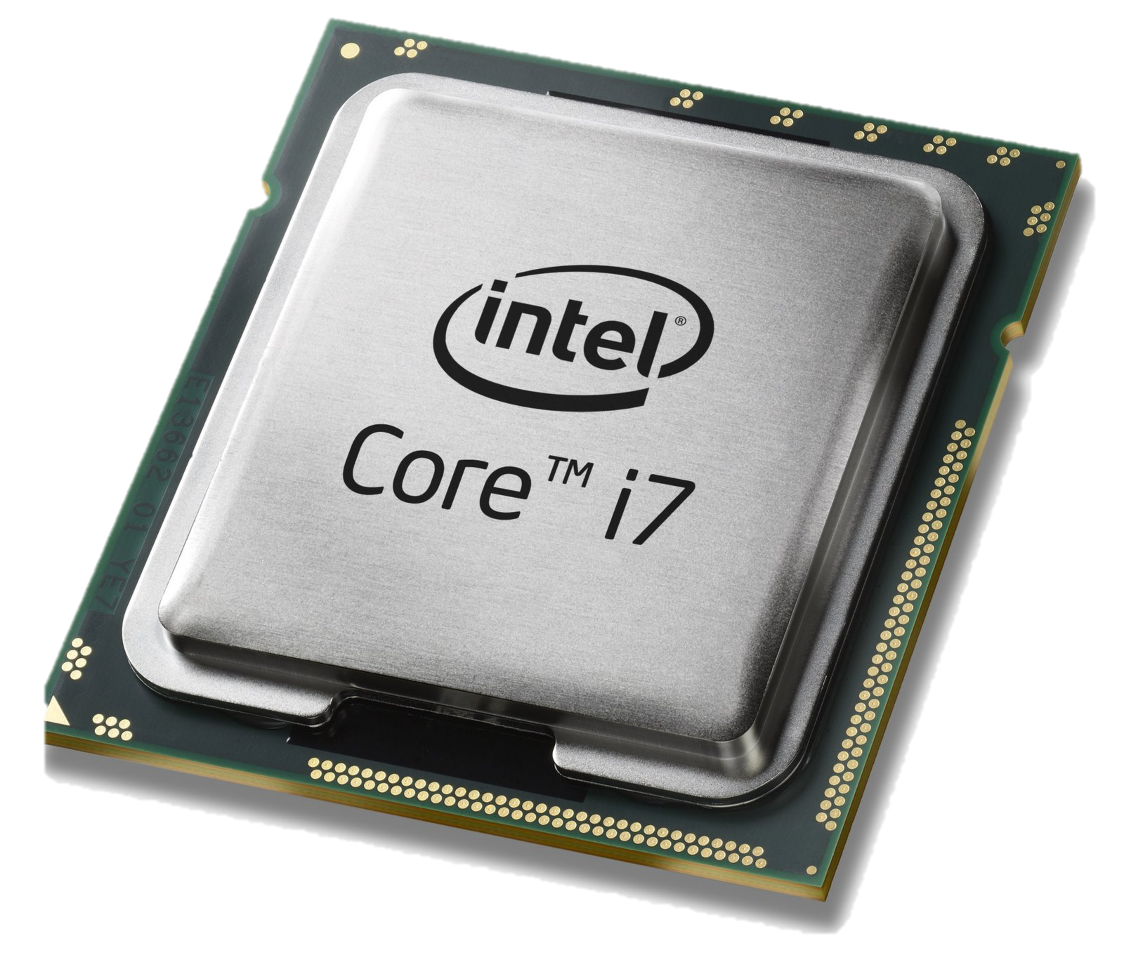
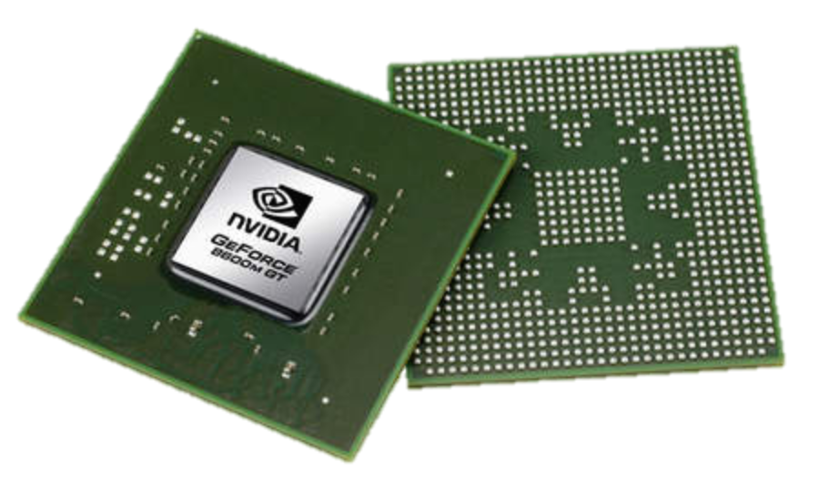
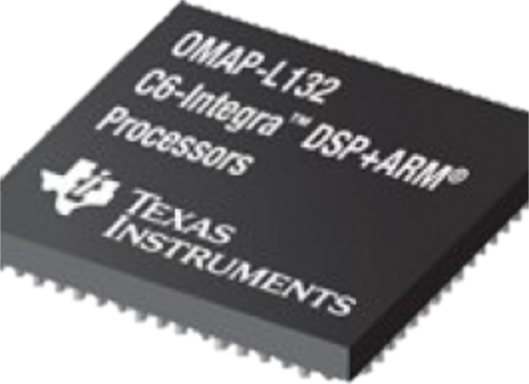
Domain Specific Processors
Signal
Processing
Machine
Learning
Computers
Graphics
Networking
Java
OpenCL
Matlab
TensorFlow
>>>
P4
Compiler
Compiler
Compiler
Compiler
Compiler
?
CPU
GPU
DSP
TPU
PISA

Slide 43
PISA: Protocol Independent Switch Architecture
Programmer declares which
headers are recognized
Programmer declares what
tables are needed and how packets are processed
Match+Action
Memory
ALU
Programmable
Parser
All stages are identical – makes PISA a good “compiler target”
Notes:
PISA chips are also built around a pipeline. But in PISA, all the pipeline stages are all IDENTICAL. They initially don’t know anything about protocols – they are sitting waiting to receive instructions from the compiler.
The basic operations of each stage is called “Match + Action” – In each stage, there is a set of memories which match on headers,
Depending on the match, an action is applied to the header by an ALU. And then the header is passed to the next stage, and so on.
A PISA chip is initially blank – it doesn’t know about any protocols.
The P4 programmer tells the programmable parser what packet headers it should recognize.
If a new header is developed, we add it to the set of headers the parser recognizes.
Let’s take a closer look at how a packet is processed …..

Slide 44
Summary of Programamable Networks
Chip speed: We can now make programmable switch chips as fast as fixed ones.
Chip technology: The difference in chip area and power between “programmable” and “fixed function” is going away.
Chip complexity: There are now too many protocols to correctly hard-code in silicon.
New ideas: Beautiful new ideas are owned by the programmer, not the chip designer.
Level playing field: Lets us create a solid platform, an abstraction layer, upon which more will be built
To learn more, visit P4.org
Notes:
Chip technology: The difference in chip area and power between “programmable” and “fixed function” is going away.
Chip complexity: There are now too many protocols to correctly hard-code in silicon.
Chip architecture: Instruction set is now known.
Chip speed: We can now make programmable switch chips as fast as fixed ones.
New ideas: Beautiful new ideas are owned by the programmer, not the chip designer.
More reliable network: Greater visibility means failures diagnosed faster. Fixes deployed quickly.

Slide 45
Wireless link characteristics
Three important differences from wired link …
Decreased signal strength: Radio signal attenuates as it propagates through matter (path loss)
Multipath propagation: Radio signal reflects off objects ground, arriving at destination at slightly different times
Interference from other sources: Standardized wireless network frequencies (e.g., 2.4 GHz) shared by other devices (e.g., phone); devices (motors) interfere as well
… make communication across (even a point-to-point) wireless link much more “difficult”

Slide 46
Wireless network characteristics
Multiple wireless senders and receivers create many problems
Multiple access issues
Hidden terminal problem

Slide 47


Hidden terminal problem
B, A hear each other
B, C hear each other
A, C can not hear each other
Hence, A, C are unaware of their interference at B
C
B
A
A
B
C
A’s signal
strength
C’s signal
strength
space

Slide 48
CSMA/CA
Sender
Receiver
Other node in
sender’s range
RTS
CTS
Data
ACK
Before every data transmission
Sender sends a Request to Send (RTS) frame with the length of transmission and the destination
Receiver respond with a Clear to Send (CTS) frame
Sender sends data
Receiver sends an ACK
If sender doesn’t get a CTS back, it assumes collision
Notes:
48

Slide 49
General goals for communication security: CIA
Confidentiality
No one read our communication
Cryptography
Message Integrity
No one can modify our communication w/o detection
Verification
Availability and Authentication
Redundancy, DoS/DDoS prevention
Only we can access our data and communicate on our behalf

Slide 50
Computer networks is a fast growing area
Software-Defined Networking
Cloud Computing
Network Virtualization
Network Testing and Verification
Big Network Data Processing
AI and Networking
Internet of Things
Bitcoin and Blockchain

Slide 51
Summary
Final exam:
Time: 7pm-9pm, Wednesday, December 16
Location: online
2021 Spring: EN.601.714 Advanced Computer Networks
THANK YOU SO MUCH!!!

Slide 52
Thanks! Q&A

